Slide 1
PROJECT
Migration of multi-tier web application from the data centre to AWS cloud

Slide 2
Initial setup and problems
Web application services running on the data center virtual machines.
Overhead cost of operations team.
Manual process & time consuming
Upfront capex and regular Opex
Scaling complexity and automation difficulty.

Slide 3
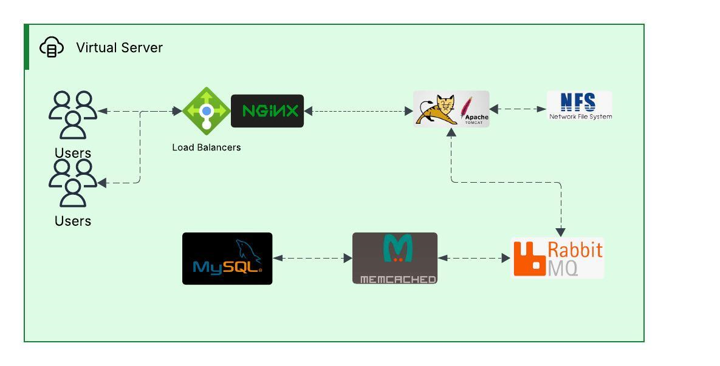
LOCAL/DATA CENTRE SETUP

Slide 4
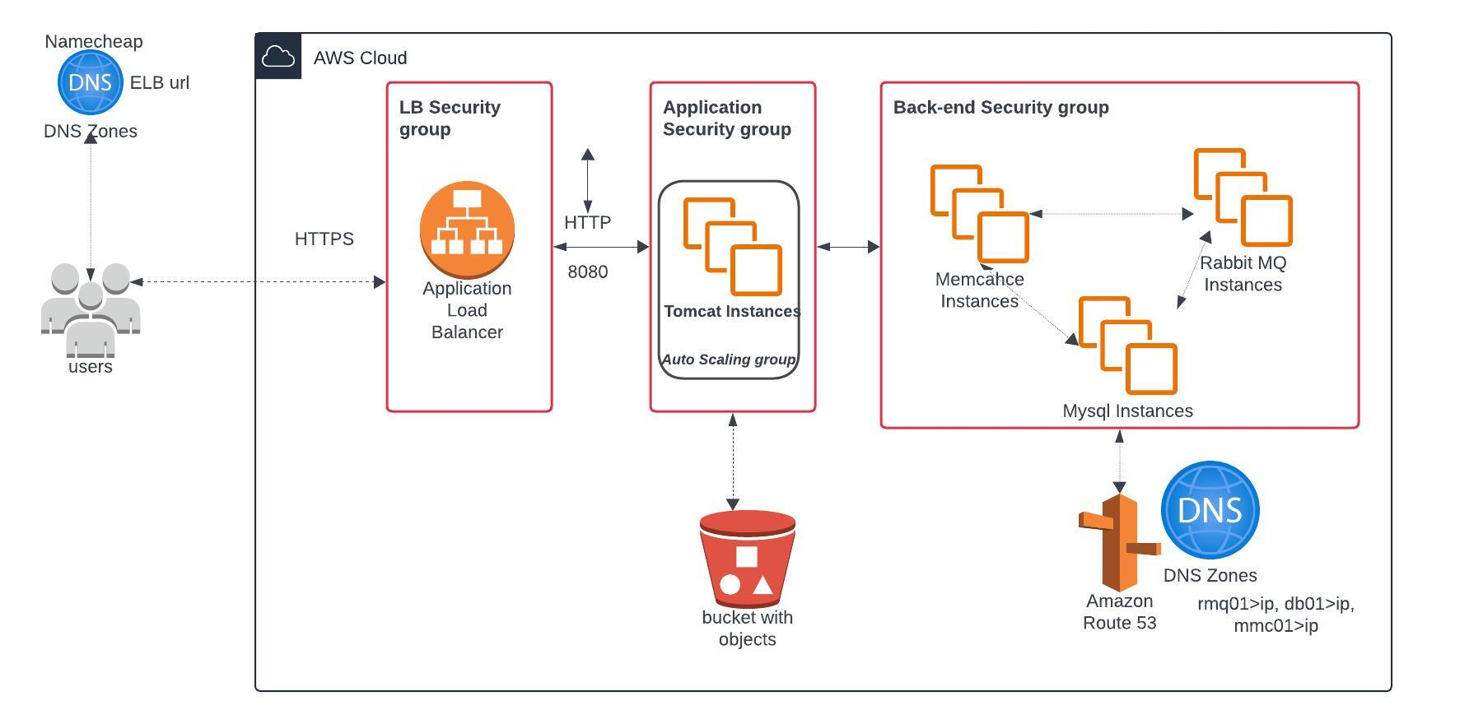
AWS CLOUD SETUP

Slide 5
Optimized setup and solution
Automated systems
PayAsYouGo
IAAS
Flexibility
Cloud based.

Slide 6
Optimized setup and solution
Automated systems
PayAsYouGo
IAAS
Flexibility
Cloud based.

Slide 7
AWS setup
NGINX, Tomcat,Memcache, rabbit MQ, Mysql.
Amazon EC2
NGNIX LB
ELB
VM scaling
Autoscaling
Shared storage
S3
Private DNS
Route 53

Slide 8
Implementation flow
1. Login to AWS Account
2. Create Key Pairs and Create Security groups
3. Launch Instances with user data (from bash scripts)
4. Update IP to name mapping in route 53
5. Build Application from source code with maven.
6. Upload to S3 bucket
7. Download artifact from S3 to Tomcat Ec2 Instance
8. Setup ELB with HTTPS (Cert from Amazon Certificate Manager)
9. Map ELB Endpoint to website name in Namecheap DNS from
10. Build Autoscaling Group for Tomcat Instances.

